Slide 1

Hospital Closure Risk
Prediction Model
Assessing the Impact of the One Big Beautiful Bill Act's
Medicaid Cuts on U.S. Hospital Financial Viability
Cheryl | Northeastern University
Master of Professional Studies in Analytics | April 2026

Slide 2
Agenda
1
Background & Policy Context
2
Dataset Description
3
Exploratory Data Analysis
4
Feature Engineering
5
Risk Classification
6
Model Training & Evaluation
7
Scenario Simulation
8
Geographic Impact Analysis
9
Key Findings & Recommendations

Slide 3

Background & Policy Context
The One Big Beautiful Bill Act and its impact on U.S. hospitals

Slide 4
The OBBBA: Key Facts
$1T
10.9M
300+
44%
Medicaid cuts
over 10 years
Americans losing
health insurance
Rural hospitals at
immediate risk
Rural hospitals with
negative margins
Signed into law July 4, 2025 (House 218-214, Senate 51-50 with VP tie-break)
New work requirements will cause Medicaid enrollment declines across 40 expansion states
States restricted from using provider taxes to fund Medicaid - cutting hospital reimbursement directly
Eligibility checks doubled from annual to every 6 months - administrative disenrollment will increase
EMTALA still requires hospitals to treat all patients - costs shift to uncompensated care
$50B Rural Health Fund provides only ~$4.5M/hospital/year for 5 years - a fraction of projected losses

Slide 5

Dataset Description
NASHP Hospital Cost Tool - 4,685 hospitals, 121 variables, 5 years

Slide 6
Dataset Overview
22,508
4,685
121
5 Years
Total records
Unique hospitals
Variables
2020-2024
Source: National Academy for State Health Policy (NASHP) Hospital Cost Tool, December 2025 release.
Compiled from Medicare Cost Reports (CMS-2552-10) submitted by all participating U.S. hospitals.
The 121 variables span six categories:
Financial performance - revenue, expenses, net income, operating margins, fund balance
Payer mix - % of patients on Medicaid, Medicare, Medicare Advantage, and commercial insurance
Payer-specific profitability - operating margin for each payer type (reveals which payers lose money)
Structural characteristics - bed size, ownership (non-profit/governmental/for-profit), urban/rural, facility type
Labor and costs - staffing levels, wages, contracted labor, cost breakdowns
Community benefit - charity care costs, uninsured/bad debt costs, drug costs

Slide 7
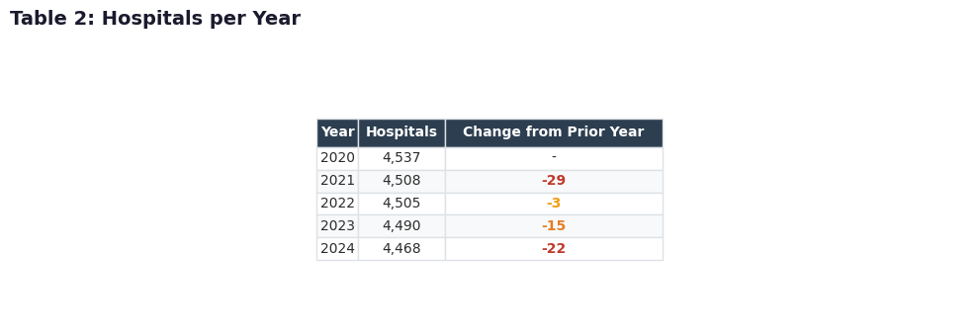
Hospitals per Year - Tracking Closures
Key Insight
69 hospitals disappeared from the dataset between 2020-2024. By analyzing the last recorded year for each, we found 217 total hospitals that appeared in earlier years but are absent in 2024 — likely closures, mergers, or conversions.
These serve as our ground truth for modeling: we can study what they looked like financially before disappearing.

Slide 8

Exploratory Data Analysis
Understanding baseline hospital financial health before cuts

Slide 9
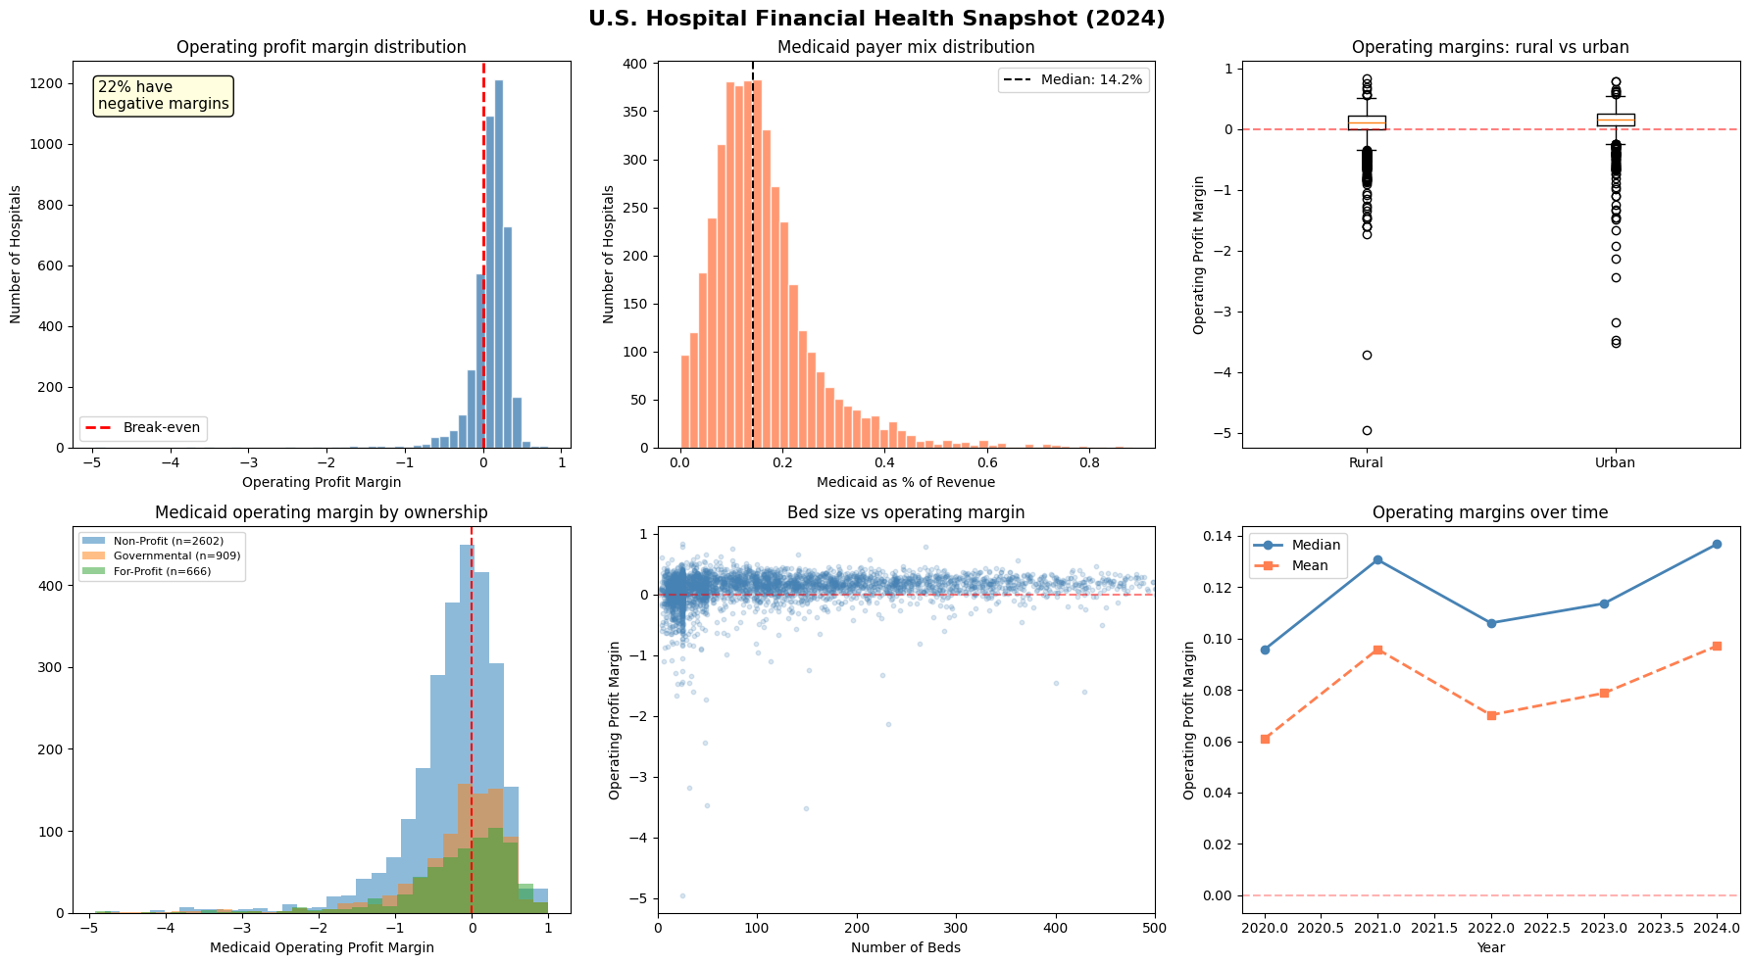
Financial Health Dashboard (2024)

Slide 10
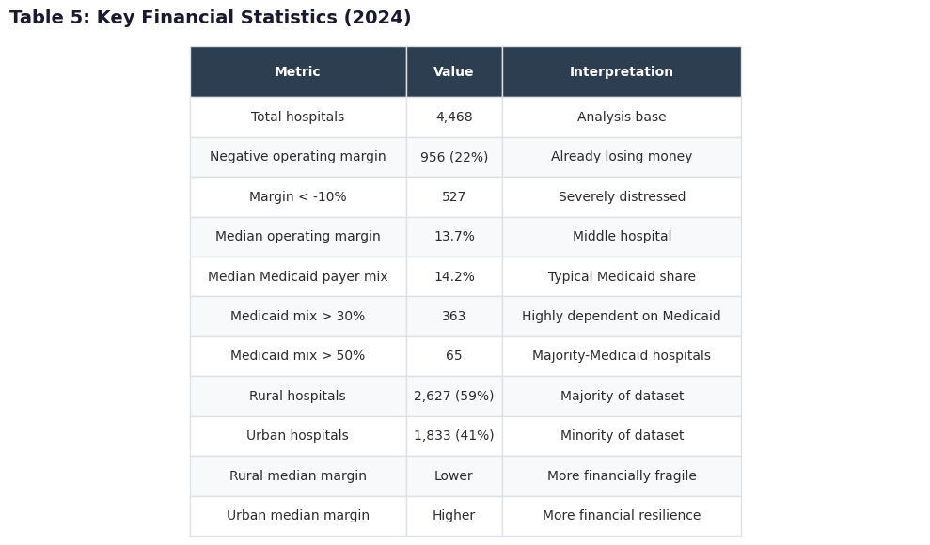
What the EDA Reveals
Critical Baseline Findings
956 hospitals (22%) already have negative margins - they are losing money before any cuts
363 hospitals depend on Medicaid for >30% of revenue - extremely exposed to cuts
Rural hospitals have lower median margins and more variability than urban hospitals
Smaller hospitals (<50 beds) show the widest spread of margins - many deeply negative
Governmental hospitals have the worst Medicaid operating margins

Slide 11
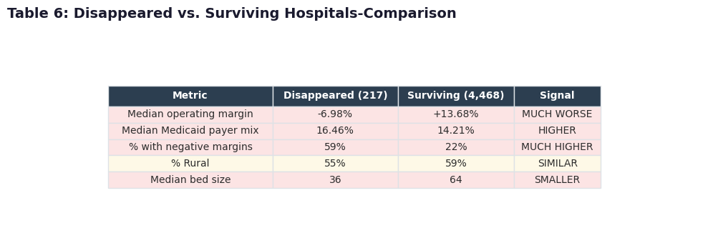
Disappeared vs. Surviving Hospitals
Why This Matters
The 217 hospitals that vanished from the dataset had:
• Median margin of -7.0% vs +13.7% for survivors
• 62% negative margins vs 22%
• Median bed size of 36 vs 64
• Higher Medicaid dependence
This validates our approach: the financial distress patterns in closed hospitals are exactly what our model learns to detect in currently operating hospitals.
These patterns will intensify under OBBBA Medicaid cuts.

Slide 12

Feature Engineering
Creating 15+ predictive signals from 121 raw variables

Slide 13
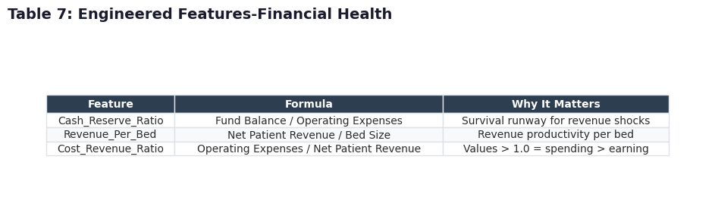
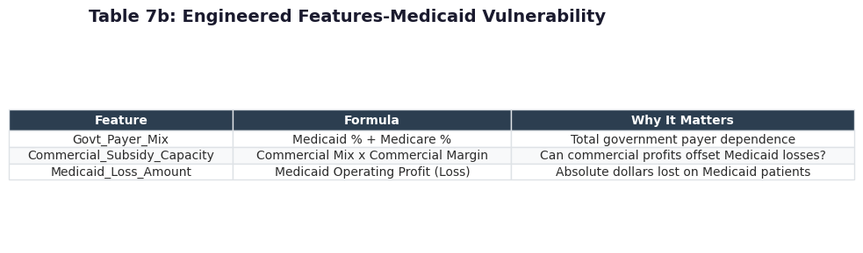
Engineered Features - Why Raw Data Isn't Enough
Feature engineering is the most impactful step in a data science project. We create new variables that capture risk patterns better than raw columns alone.
Trend features (unique to this analysis):
• Margin_Trend: 5-year linear regression slope of operating margin - negative = deteriorating
• Recent_Decline: binary flag for margin drop in last 2 years - captures recent worsening
-A hospital trending downward is riskier than one at the same level but stable.

Slide 14
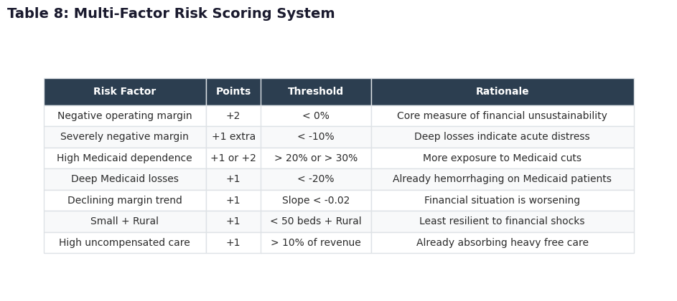
Risk Scoring System — 6 Simultaneous Factors
Design Rationale
A single warning sign may not indicate closure risk --hospitals can have one bad year and recover.
But when 5+ risk factors appear simultaneously, the probability of closure or severe service cuts increases dramatically.
The scoring system is informed by the financial profiles of the 217 hospitals that actually disappeared from the dataset.

Slide 15
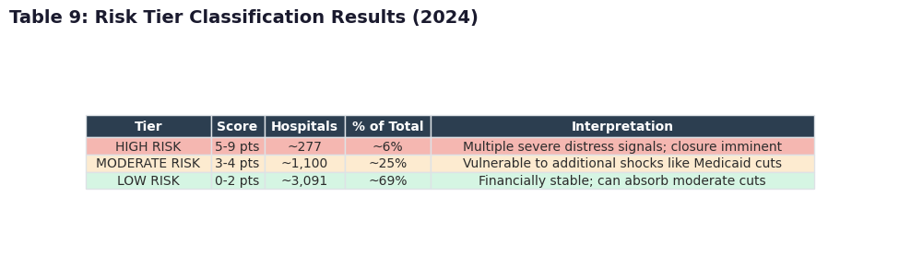
Risk Tier Classification Results
What the Tiers Mean
HIGH RISK (277 hospitals):
Multiple severe distress signals; immediate closure risk. These need urgent intervention.
MODERATE RISK (~1,100):
Some distress signals present. Vulnerable to additional shocks like the OBBBA Medicaid cuts.
LOW RISK (~3,091):
Financially stable. Can likely absorb moderate revenue reductions.
The model's target variable: Is_High_Risk (binary: 1 if Tier 3, 0 otherwise)

Slide 16

Model Training & Evaluation
Three algorithms compared - Random Forest selected

Slide 17
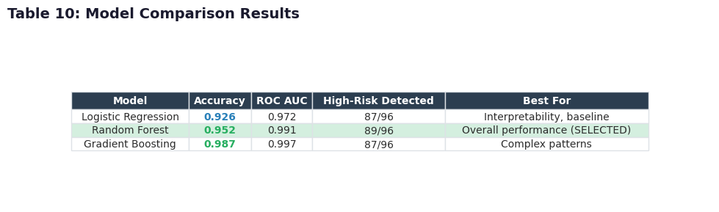
Model Comparison
Why Three Models?
Logistic Regression: Simple baseline. Draws a linear boundary between at-risk and stable hospitals.
Random Forest: 200 decision trees vote independently. Reduces overfitting.
Gradient Boosting: Trees built sequentially, each correcting prior mistakes.
Random Forest was selected for the highest ROC AUC, meaning it best distinguishes high-risk from stable hospitals.
All models used class_weight='balanced' to prevent defaulting to 'not at risk' for all hospitals.

Slide 18
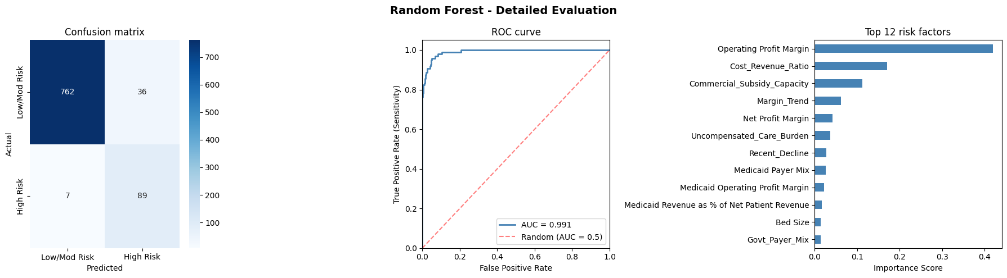
Model Evaluation - Confusion Matrix, ROC, Feature Importance
Left: Confusion matrix , how many at-risk hospitals were correctly identified vs missed. Center: ROC curve, tradeoff between catching all at-risk hospitals and avoiding false alarms. Right: Feature importance, the factors that most strongly predict closure risk.
Top 5 predictors: Operating Profit Margin, Medicaid Payer Mix, Margin Trend, Government Payer Dependence, Bed Size

Slide 19

Scenario Simulation
What happens when Medicaid revenue drops 5% to 30%?

Slide 20
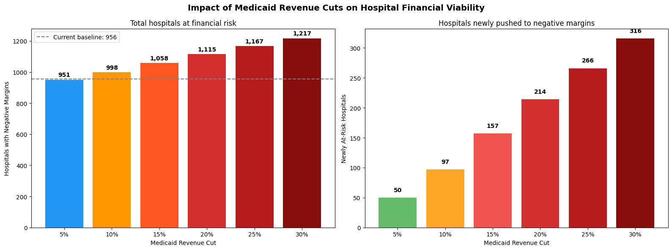
Scenario Simulation - OBBBA Medicaid Cut Impact
How this works: For each hospital, we estimate Medicaid revenue (Net Patient Revenue × Medicaid %), then reduce it by 5-30%. Since EMTALA requires hospitals to keep treating patients, costs don't decrease the revenue loss comes directly off operating profit. We count how many hospitals cross from positive to negative margins at each cut level.
The 20% scenario aligns with CBO projections of the OBBBA's cumulative impact.

Slide 21
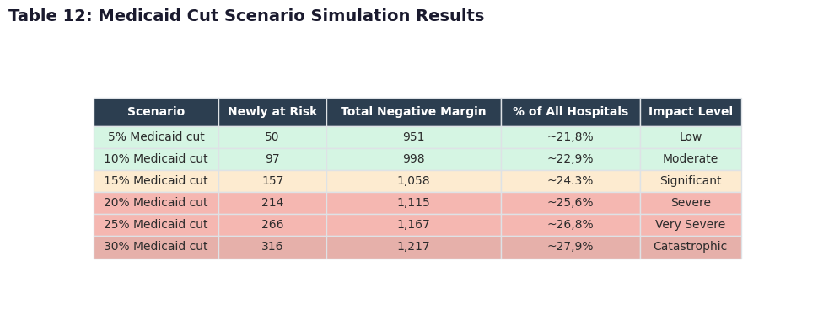
Scenario Results Summary
Interpretation
At 5-10%: Impact concentrated among hospitals already near break-even.
At 15-20%: Rural hospitals hit disproportionately. Hundreds of additional hospitals pushed into negative margins.
At 25-30%: Urban hospitals begin showing vulnerability. Nationwide acceleration of closures.
The cascade effect is critical, each closure forces remaining hospitals to absorb more uncompensated care, pushing them closer to their own tipping point.

Slide 22

Geographic Impact Analysis
Which states and communities face the greatest risk?

Slide 23
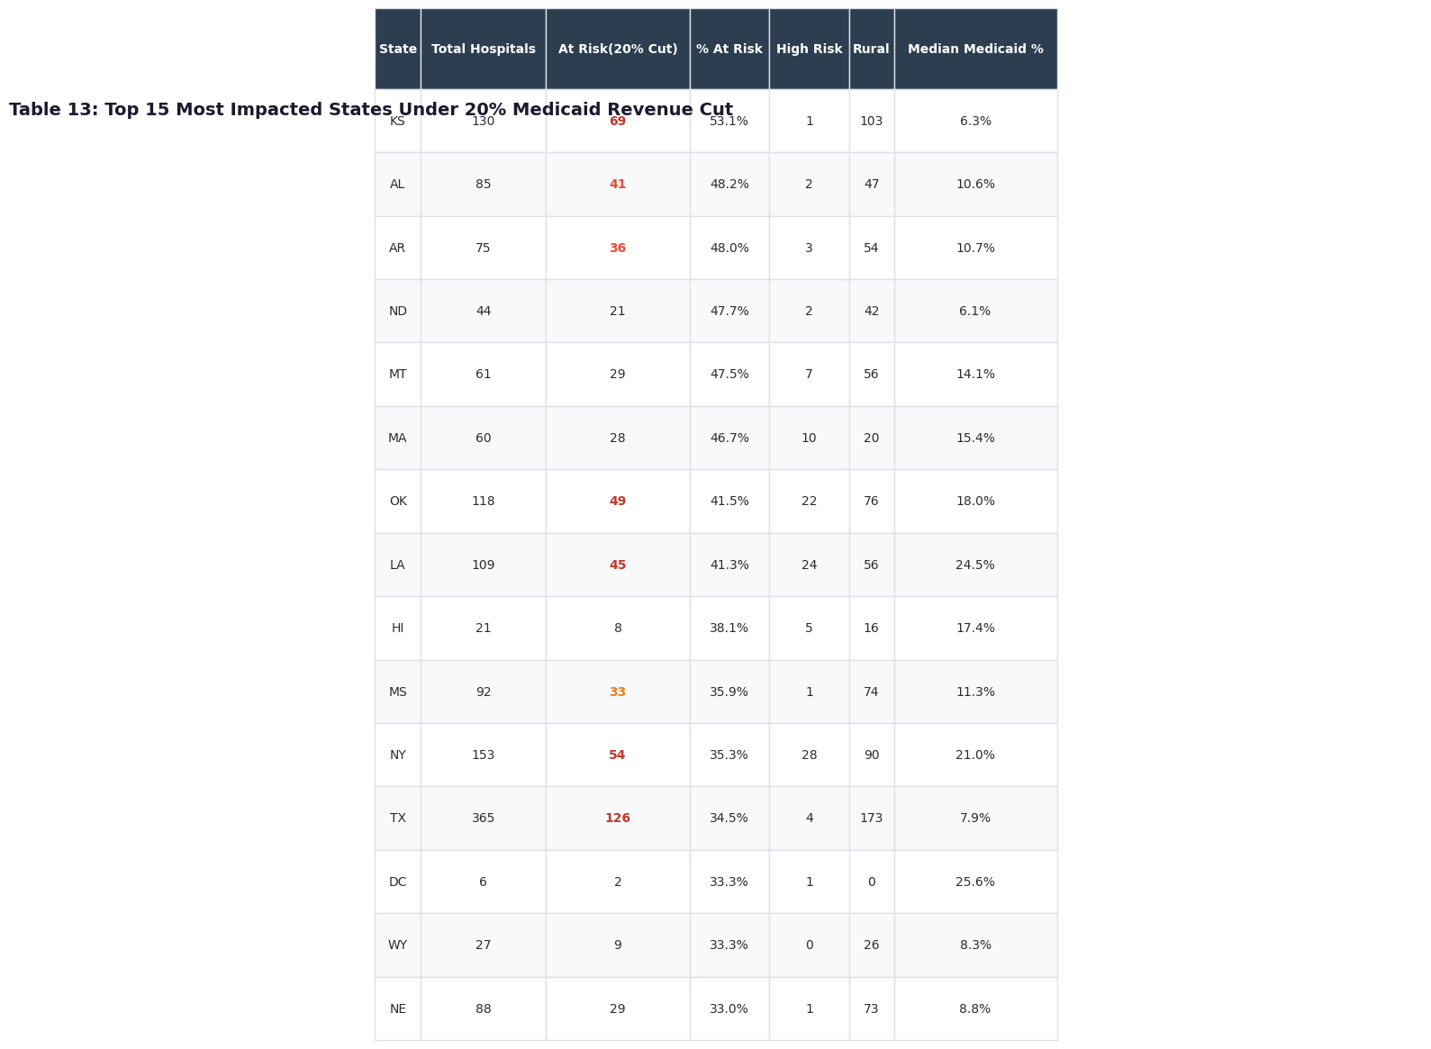
Top 15 Most Impacted States (20% Medicaid Cut)
State-Level Patterns
Kansas (53%), Alabama (48%), Arkansas (48%): Heavily rural states with many small hospitals near break-even.
New York (35%), Massachusetts (47%): Safety-net hospitals with very high Medicaid populations (50-80%).
Oklahoma (42%), Louisiana (41%): Non-expansion or high-poverty states with limited commercial revenue to cross-subsidize.
Texas (35%): Largest absolute number at risk (126 hospitals) due to sheer size.

Slide 24
Top 13 Most At-Risk Hospitals (by Medicaid Dependence)
These hospitals have both negative operating margins AND the highest Medicaid patient percentages- the combination most vulnerable to OBBBA cuts.
Hospital | City | ST | Beds | Op. Margin | Medicaid %
Lincoln Medical & Mental Health Ctr | Bronx | NY | 287 | -3.0% | 83.1%
Laguna Honda Hospital | San Francisco | CA | 6 | -110.1% | 80.1%
Bellevue Hospital Center | New York | NY | 527 | -2.1% | 79.6%
College Hospital Costa Mesa | Costa Mesa | CA | 122 | -21.0% | 78.0%
Jacobi Medical Center | Bronx | NY | 440 | -3.9% | 75.3%
Adair County Health Center | Stilwell | OK | 30 | -0.1% | 74.8%
Loma Linda Univ Childrens Hosp | Loma Linda | CA | 364 | -16.6% | 72.7%
Metropolitan Hospital Center | New York | NY | 196 | -2.7% | 72.0%
NYC Health+Hospital / S. Brooklyn | Brooklyn | NY | 252 | -0.9% | 71.0%
Martin Luther King Community Hosp | Los Angeles | CA | 152 | -124.0% | 71.0%
Kern Medical Center | Bakersfield | CA | 222 | -31.9% | 68.9%
San Mateo Medical Center | San Mateo | CA | 69 | -97.8% | 68.7%
Adventist Health Reedley | Reedley | CA | 49 | -0.1% | 65.6%
Dominated by California (safety-net county hospitals) and New York (NYC Health + Hospitals system)

Slide 25
Top 25 Most At-Risk Hospitals (continued: #14-25)
Hospital | City | ST | Beds | Op. Margin | Medicaid %
Arrowhead Regional Medical Ctr | Colton | CA | 366 | -45.5% | 62.2%
Alameda Health System | Oakland | CA | 232 | -213.1% | 60.7%
Harlem Hospital Center | New York | NY | 217 | -0.6% | 59.7%
Los Angeles Community Hospital | Los Angeles | CA | 173 | -6.3% | 59.6%
Othello Community Hospital | Othello | WA | 16 | -6.3% | 58.9%
Kohala Hospital | Kapaau | HI | 25 | -59.1% | 57.4%
Alameda Hospital | Alameda | CA | 66 | -39.9% | 56.6%
St. Bernard Hospital | Chicago | IL | 114 | -25.5% | 56.2%
Natividad Medical Center | Salinas | CA | 144 | -11.6% | 53.9%
Zuckerberg SF General | San Francisco | CA | 284 | -17.2% | 52.8%
Anaheim Global Medical Ctr | Anaheim | CA | 103 | -11.3% | 51.5%
Victor Valley Global Medical Ctr | Victor Valley | CA | 101 | -7.9% | 50.4%
Pattern: These are predominantly public safety-net hospitals serving low-income communities. All have Medicaid dependence >50% and negative margins -OBBBA cuts will deepen their losses.

Slide 26

Key Findings & Recommendations
From data to actionable policy

Slide 27
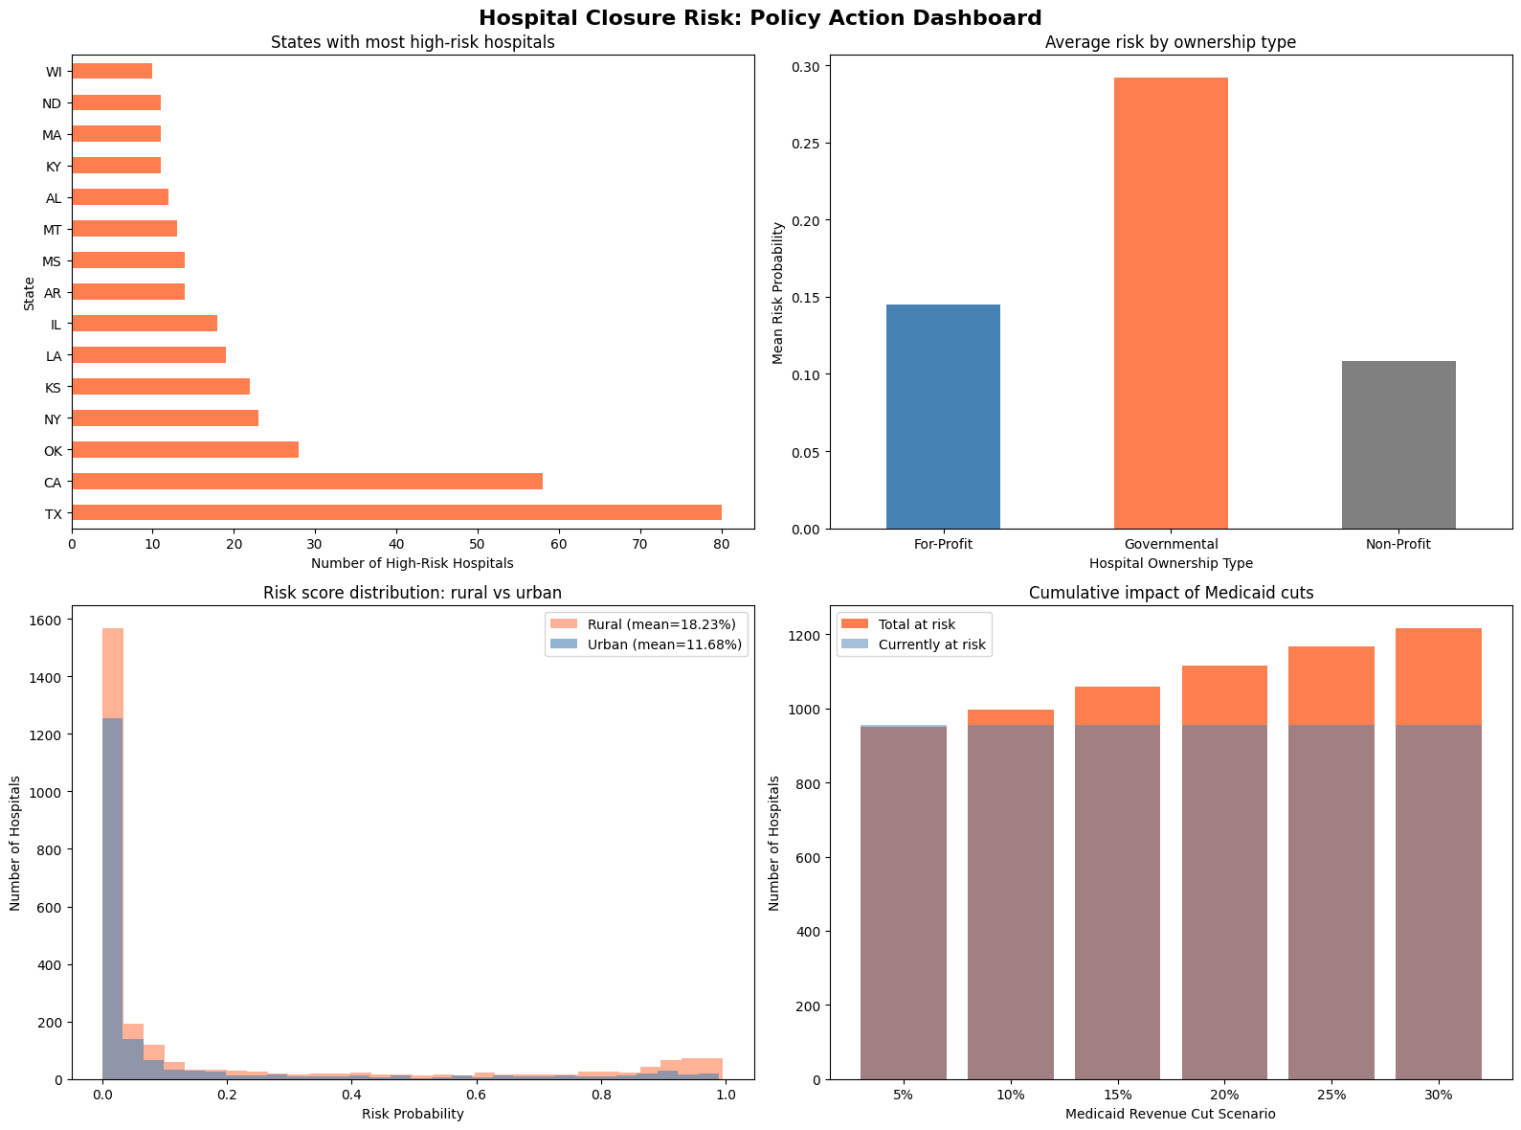
Policy Action Dashboard

Slide 28
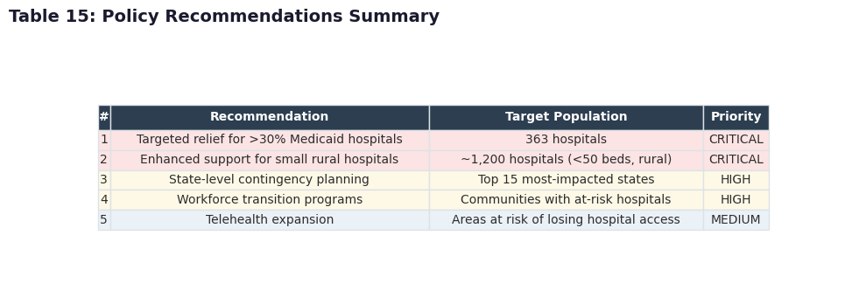
Policy Recommendations
Action Priorities
CRITICAL: Target the 363 hospitals with >30% Medicaid dependence using risk-stratified allocation from the Rural Health Fund.
CRITICAL: Enhanced support for ~1,200 small rural hospitals (<50 beds) with cost-based reimbursement.
HIGH: State-level contingency plans before closures occur.
HIGH: Workforce transition programs for affected communities.
MEDIUM: Telehealth infrastructure investment.

Slide 29
Key Findings Summary
22% already distressed
956 hospitals have negative operating margins before any OBBBA cuts take effect. This is the vulnerable baseline the legislation will worsen.
Medicaid = #1 predictor
Medicaid payer mix is the strongest predictor of closure risk. 363 hospitals with >30% Medicaid dependence face the most acute threat.
Rural hospitals 2x at risk
Rural hospitals have lower margins, smaller beds, and less commercial revenue to cross-subsidize. 2,627 rural hospitals are disproportionately represented in all high-risk categories.
217 hospitals already gone
Closures from 2020-2024 followed predictable financial patterns - the same patterns our model now detects in currently operating hospitals.
20% cut = hundreds more
The scenario simulation shows that a 20% Medicaid revenue reduction (aligned with CBO estimates) pushes hundreds of additional hospitals from positive to negative margins.

Slide 30
Thank You
Hospital Closure Risk Prediction Model
Cheryl | Northeastern University
Master of Professional Studies in Analytics | April 2026

